Slide 1
C++ Programming Today 2nd Edition By Barbara Johnston Chapter 2
Instructor: <Instructor Name>
Lecture Slides by Kelly Montoya and Rob Garner

Slide 2
Quiz, Make a Project

Slide 3
Chapter 2
Programming Fundamentals
Steps to Programming Success
Computer Programming Terminology
Format of a C++ program
Commenting Code
Preprocessor Directives
Main Function
C++ Statements
Sample Code
Whitespace
Language Syntax and Compiler Errors
Keywords
Commenting
Data Types
Variable Declaration
Initializing Variables
Operators
Stored Values
Arithmetic Operators
Precedence of operations
Accumulation
Getting Data to/from User
#define Preprocessor Directive
Const Modifier
Data Casts
Formatting Output
String Class

Slide 4
#define preprocessor directive
Explain how to use the #define preprocessor directive.

Slide 5
#define
#define is a preprocessor directive that gives the compiler instructions.
The #define statement is a symbolic constant and performs a substitution in the code.
The form of the #define statement is:
#define symbolic_name character_sequence
Example: #define PI 3.14159265
Note that there is no semicolon at the end of the statement.

Slide 6
#define
The #define is convenient for coding numeric constants and gives an easy way to remember words instead of numbers.
If a program needs to have numeric constants, the software is written with #define statements.
Common C++ conventions:
Use capital letters for #define constants.
Place them at the top of the file.
Notes:
#define statements are shown in Program 2-15.

Slide 7
#define
#define allows you to change one line of code rather than every time the value is used.
Here are three more examples:
#define MAX 100
#define FILE_IN “F:\data\input.dat”
#define HOURLY_RATE 8.50
It is also easier to remember FILE_IN rather than a long path and file name.

Slide 8
#define
You could use #define for PI.
#include <iostream>
using namespace std;
#define PI 3.14159265
int main()
{
double circleArea, radius = 5.0;
circleArea = PI * radius * radius;
cout << "\n Circle area" << circleArea;
return 0;
}

Slide 9
Where should #define statements be located in your program?
At the top of the program.
Anywhere in the program where you would declare any other variable.

Slide 10
Const Modifier
Explain how to use the const modifier.

Slide 11
The const Modifier
const is used in variable declaration statements.
The constant’s value remains the same throughout the program and cannot be changed.
The form is:
const data_type variable_name = initial_value;
Example: const double x = 7.1111;
Notes:
Program 2-16 demonstrates the const modifier.

Slide 12
The const Modifier
Here we use const for PI.
#include <iostream>
using namespace std;
int main()
{
const double PI = 3.14159265;
double circleArea, radius = 5.0;
circleArea = PI * radius * radius;
cout << "\n Circle area" << cArea;
return 0;
}

Slide 13
Where should const statements be located in your program?
At the top of the program.
Anywhere in the program where you would declare any other variable.

Slide 14
Data Casts
Explain how to cast a value to a different data type.

Slide 15
Data Casts
Data casting is an operation where one type of data is transformed into another type of data.
The static_cast is the one most commonly required in C++ programs.
The general form is:
static_cast<data_type>(value)

Slide 16
Data Casts
Convert the double value of 2.0 into a float value.
Cast a character variable that contains the letter ‘B’ into an integer variable named number.
float r = static_cast<float>(2.0);
char letter = 'B';
int number = static_cast<int>(letter);
Notes:
Program 2-17 shows more casting.

Slide 17
Write the code to cast the float 3.5F to an int (the F tells the compiler 3.5 is a float not a double).

Slide 18
Formating Output
Demonstrate how to format output.

Slide 19
More Details on Keyboard Input and Screen Output
Escape Sequences
The \ symbol tells C++ to do something special when writing output.
Notes:
See Program 2-18 for various escape sequences.

Slide 20
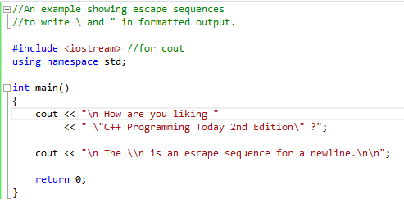
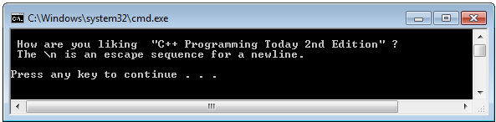
Escape Sequences
New Line
Show a ”
Show a “
Show a \

Slide 21
ios Formatting Flags
ios formatting flags can be thought of as on-off switches that control how output data is written.
Notes:
Program 2-19 illustrates how the precision and fixed flag work together to produce a variety of output formats.

Slide 22
IOS Formatting Flags Sample Program
Show Program 2-19

Slide 23
Stream IOManipulators
Include the <iomanip> library to use manipulators directly in the output stream.
setw() sets the field width for the variable output that follows.
setw( ) reserves five spaces to write the value of the variable x:
cout << "\n The value of x is " << setw(5) << x;
Notes:
Program 2-20 shows how you can place the flags in the cout statement itself to control the appearance of your output.

Slide 24
String Class
Explain how to use the string class.

Slide 25
Get Started using Classes and Objects, the C++ string
Think of a class as a job description—which lists the tasks that must be performed by an individual doing that job.
The object is the actual individual who is performing that job.
The C++ string class is contained in the <string> library and is used to handle text data in your program.

Slide 26
String Class
The string class provides many operators and other functions for searching, assigning, and manipulating data within the string object.
The way we ask an object to do one of its tasks is by using the object’s name, the dot operator (which is a period) and the name of the task.
string baseballTeam = "Albuquerque Isotopes";
string teamMascot = "Orbit";
int teamSize = baseballTeam.size();
//teamSize is assigned 20, because there are
//20 chars in “Albuquerque Isotopes”
int mascotSize = teamMascot.size();
//mascotSize is assigned 5
Notes:
Program 2-21 illustrates how to declare string objects and use them in a program.

Slide 27
String Class
The string class has a task named “find().”
When we use the object name, the dot operator and find() we can pass into the find function what we want it to look for in its own data.
find() returns the location where that data is located or a -1 if not found
Visual C++ 2005 gives you the class’ pick list (of functions) when the dot operator is used.
Notes:
Program 2-22 asks the user to enter a sentence and a word.

Slide 28
String Class
Here we use find() for our strings.
#include <iostream>
#include <string>
using namespace std;
int main()
{
string Team = "Albuquerque Isotopes";
string nickName = "topes";
//see if the nickName is in the Team name
int loc = Team.find(nickName);
cout << "Results" << loc << "= -1 No";
return 0;
}

Slide 29
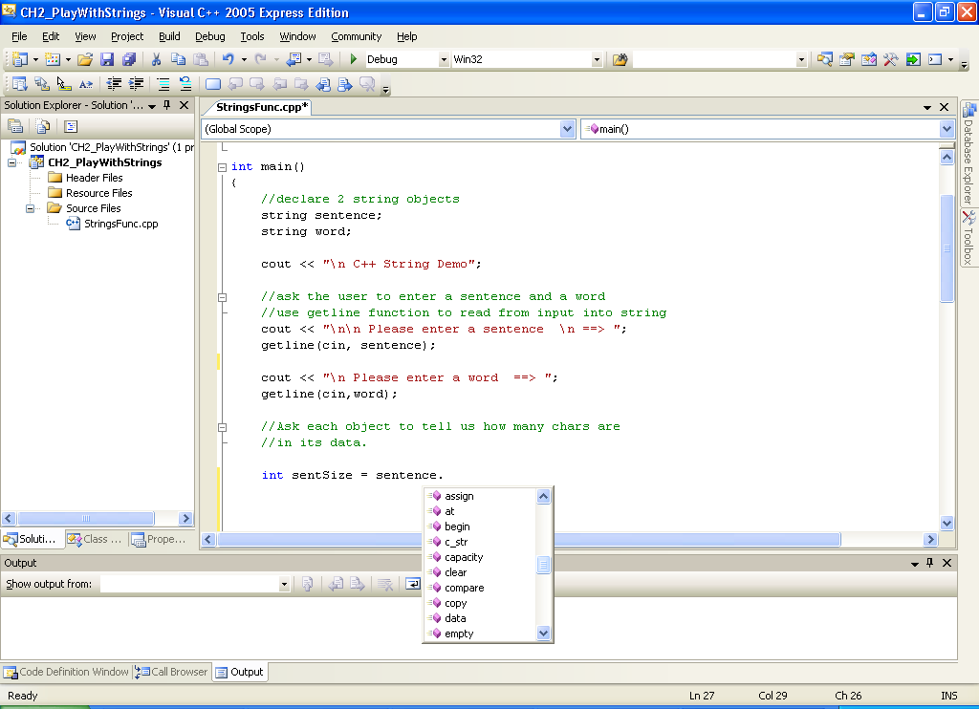
VC++ shows us the pick list of all the string functions!
Sentence is a string object in our program. When I use the sentence
(and dot operator) you will see the functions associated with that class.

Slide 30
Formatting and Strings Demo
Demonstrate how to format output and use strings.

Slide 31
Debugger
Explain how to use Visual Studio's Debuger.

Slide 32
One Final Note
See Appendix I for instructions on how to use the debugger.
The debugger is a very powerful tool that will help you find out what exactly is going on in your program.
You can troubleshoot problems as well as track all of the variables in your program.

Slide 33
Chapter 2
Programming Fundamentals
Steps to Programming Success
Computer Programming Terminology
Format of a C++ program
Commenting Code
Preprocessor Directives
Main Function
C++ Statements
Sample Code
Whitespace
Language Syntax and Compiler Errors
Keywords
Commenting
Data Types
Variable Declaration
Initializing Variables
Operators
Stored Values
Arithmetic Operators
Precedence of operations
Accumulation
Getting Data to/from User
#define Preprocessor Directive
Const Modifier
Data Casts
Formatting Output
String Class

